Slide 1
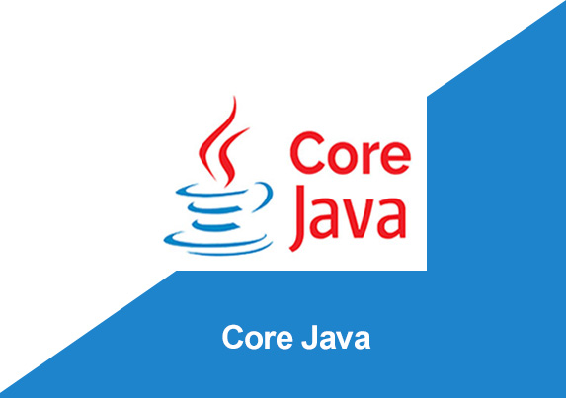
By: Manas Tuwani

Slide 2
ABSTRACTION
Representing essential features by hiding background details is called Abstraction
Data Abstraction is the property by virtue of which only the essential details are displayed to the user. The trivial or the non-essentials units are not displayed to the user.
Ex: A car is viewed as a car rather than its individual components.
Data Abstraction may also be defined as the process of identifying only the required characteristics of an object ignoring the irrelevant details. The properties and behaviours of an object differentiate it from other objects of similar type and also help in classifying/grouping the objects.

Slide 3

ABSTRACTION

Slide 4
Abstract classes and Abstract methods
An abstract class is a class that is declared with abstract keyword.
An abstract method is a method that is declared without an implementation.
An abstract class may or may not have all abstract methods. Some of them can be concrete methods.
A method defined as a abstract must always be redefined in the subclass, thus making overriding compulsory OR make subclass itself abstract.
Any class that contains one or more abstract methods must also be declared with abstract keyword.
There can be no object of an abstract class. That is, an abstract class can not be directly instantiated with the new operator.

Slide 5
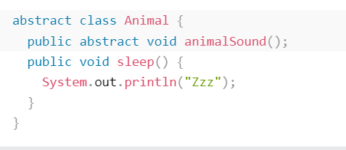

An abstract class can have both abstract and regular methods:
From the example above, it is not possible to create an object of the Animal class:
To access the abstract class, it must be inherited from another class.

Slide 6
Note:
In java, abstraction is achieved by interfaces and abstract classes. We can achieve 100% abstraction using interfaces.

Slide 7
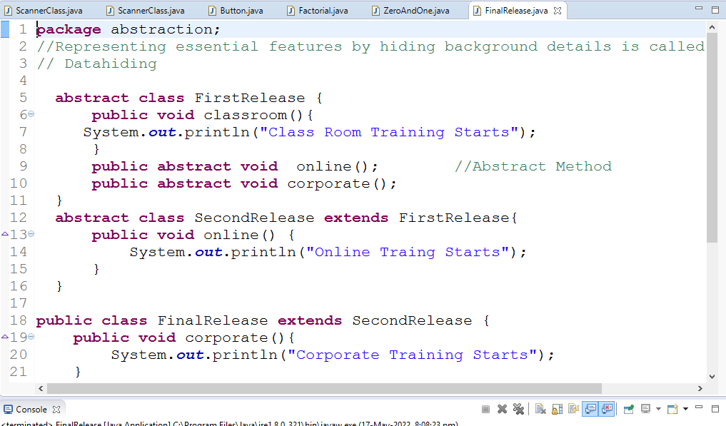

Slide 8
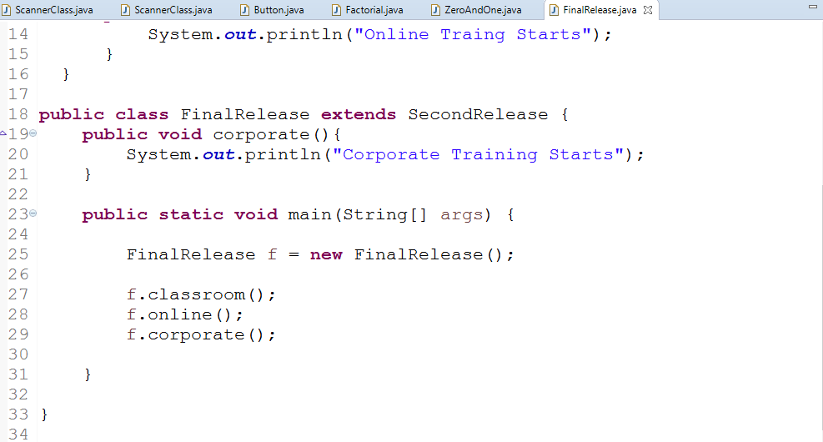
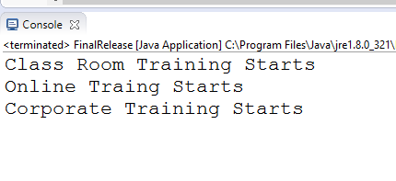

Slide 9
Why And When To Use Abstract Classes and Methods?
To hide the data- hide certain details and only show the important details of an object.

